Slide 1

Sprint One Elaboration

Slide 2
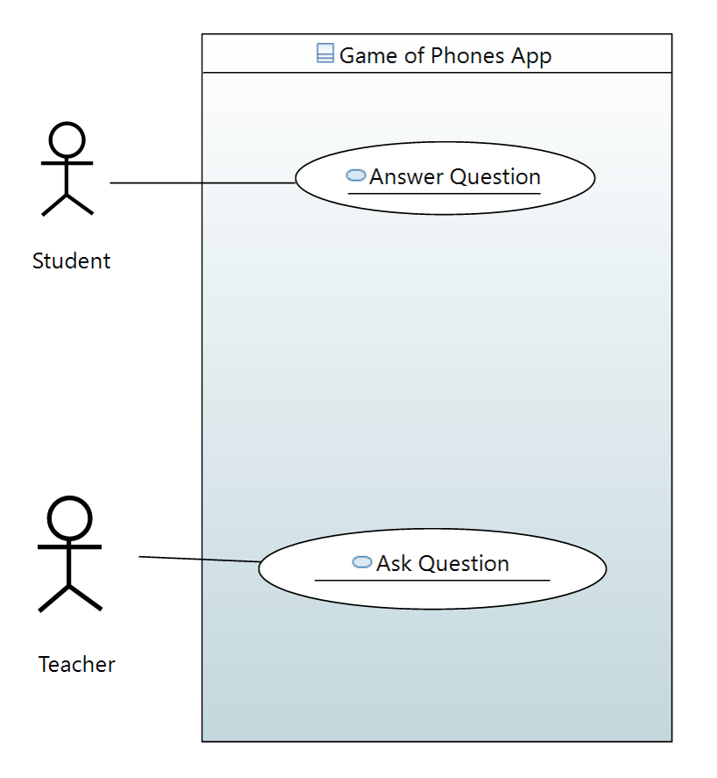

Slide 3
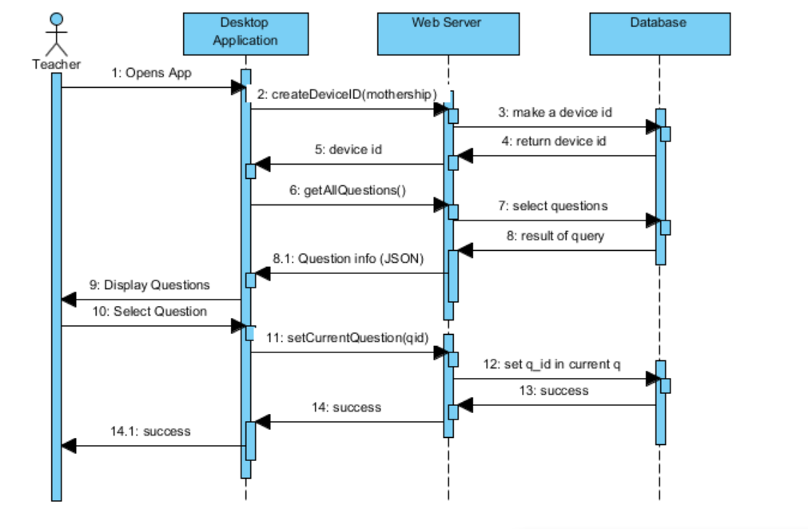

Slide 4
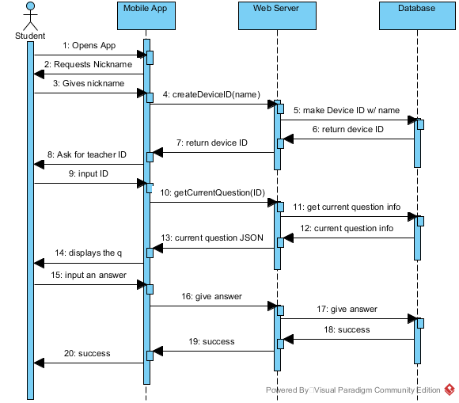

Slide 5
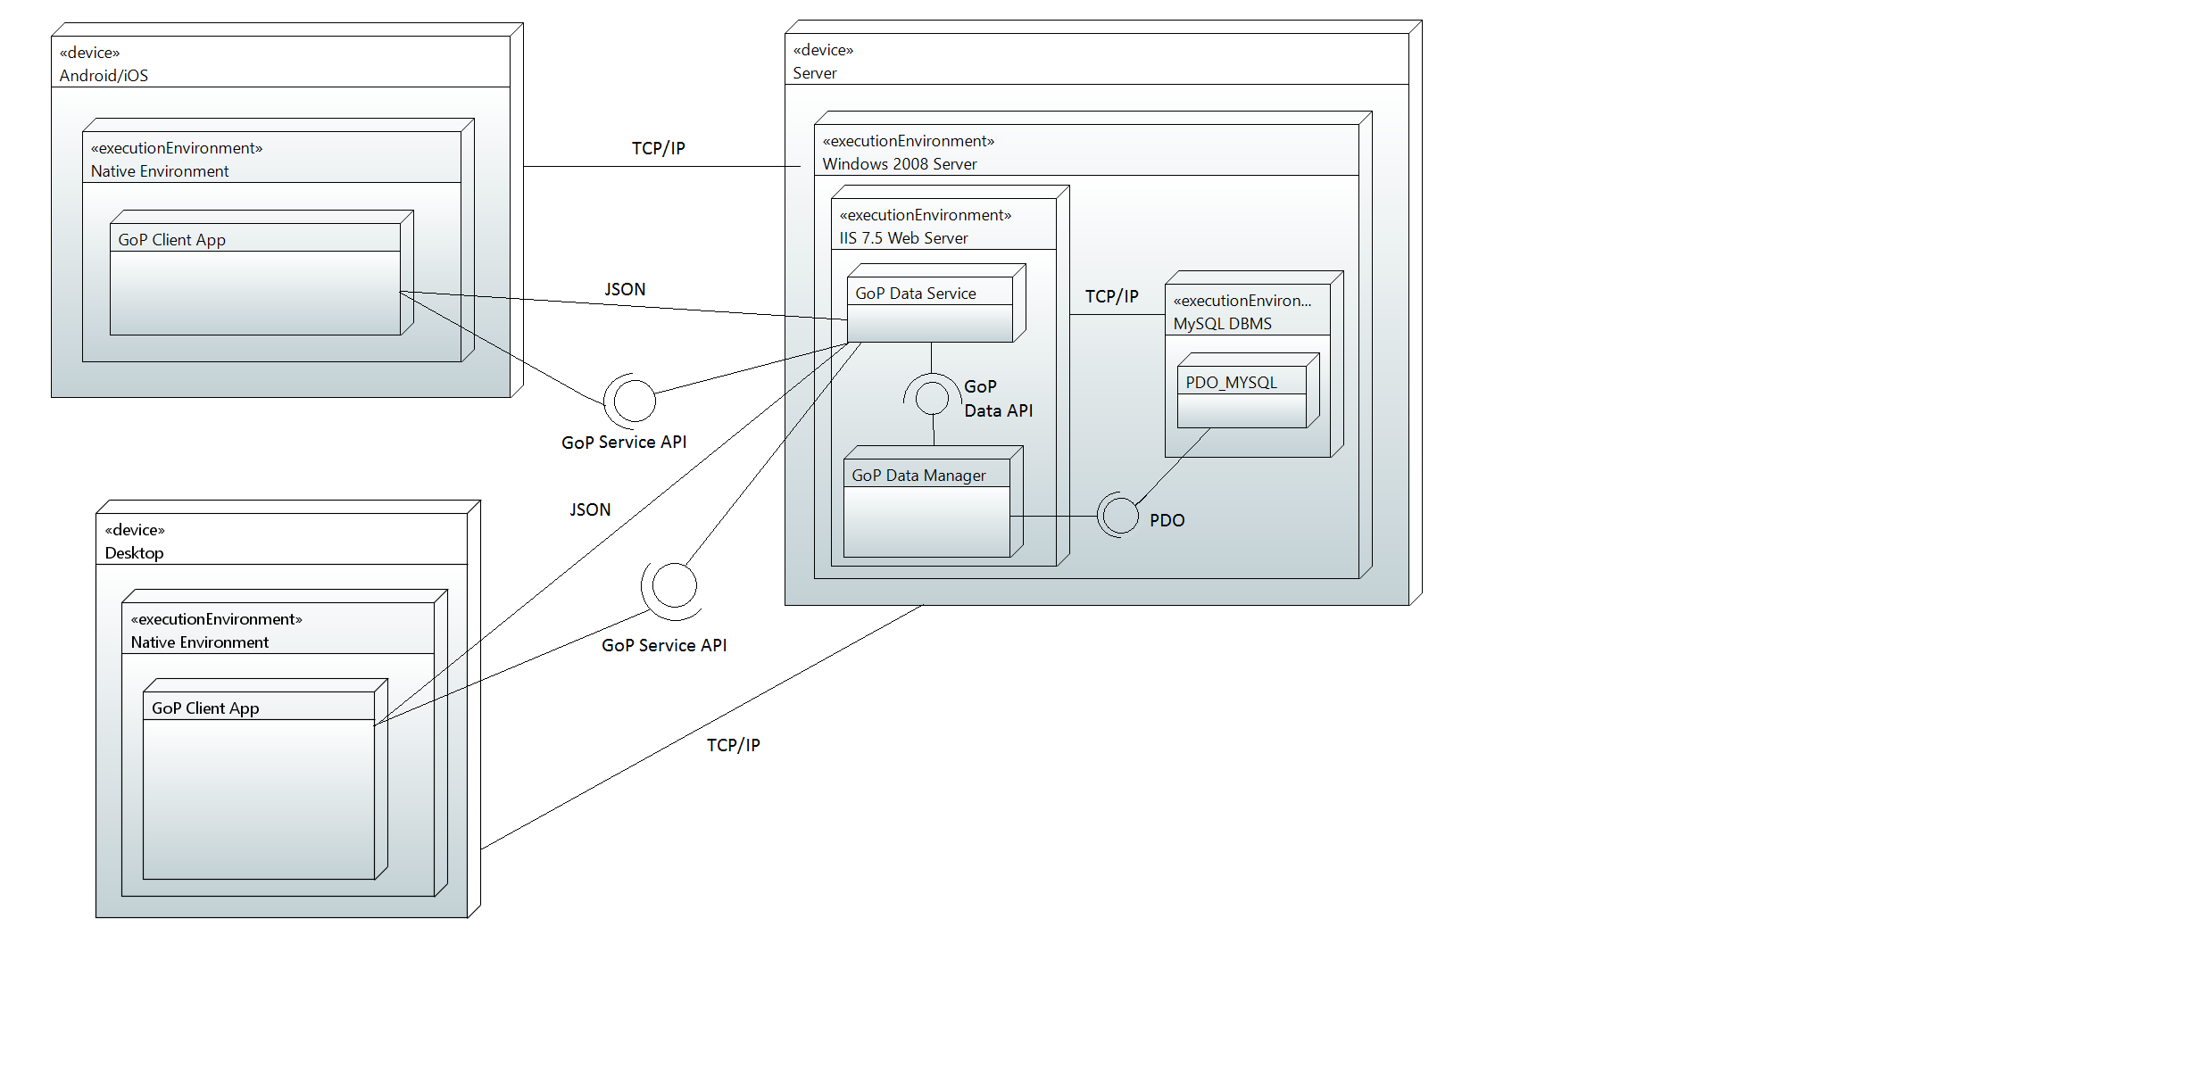

Slide 6
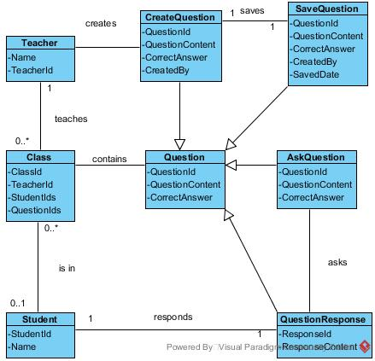

Slide 7
Acceptance plan
Actions on Sequence Diagram
Testing
Invalid answers, checking the database

Slide 8
What comes next
Kyle and Josh: Work on learning xcode
Zach: Work on getting the desktop app working
Amelia and Stephanie: Work on Android application
When: Week after Thanksgiving (ish)

Slide 9
Questions?

